Slide 1
GENETIC ALGORITHMS
Introduction

Slide 2
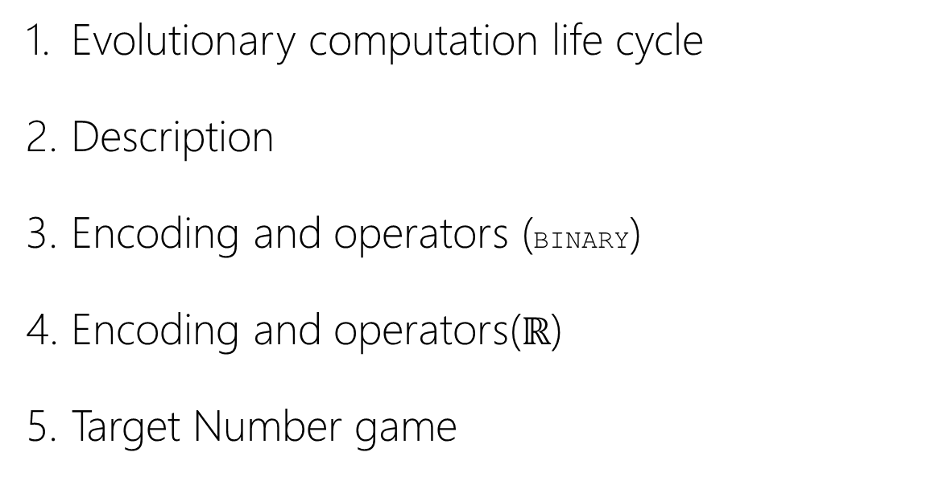
ÍNDICE
Evolutionary computation life cycle
Description
Encoding and operators (BINARY)
Encoding and operators($ℝ$)
Target Number game

Slide 3




Evolutionary Computation Life-cycle
INITIALIZE POPULATION
FINAL
POPULATION
¿ FOUND SOLUTION?
F(x) = 0.37 0<F(X)<1
F(x) = 0.89 0<F(X)<1
SELECTION
CROSS-OVER
MUTATION
EVALUATION
REPLACEMENT

Slide 4
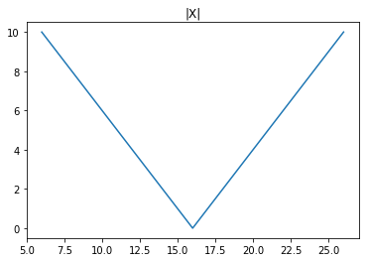

Description
Find minimum value
$f\left(x\right)=|x−16|$

Slide 5


Description
SOLUTION
SPACE
SEARCH
SPACE
-∞
…
-6
-5
-4
-3
-2
-1
0
1
2
3
4
5
6
7
..
+∞
0
1
2
3
4
5
6
7
8
9
10
11
12
13
14
15
Find minimum value
$f\left(x\right)=|x−16|$

Slide 6




Description
SOLUTION
SPACE
SEARCH
SPACE
0
1
2
3
4
5
6
7
8
9
10
11
12
13
14
15
16
17
0000
0001
0010
0011
0100
0101
0110
0111
1000
1001
1010
1011
1100
1101
1110
1111
Find minimum value
$f\left(x\right)=|x−16|$

Slide 7
BINARY ENCODING

Slide 8
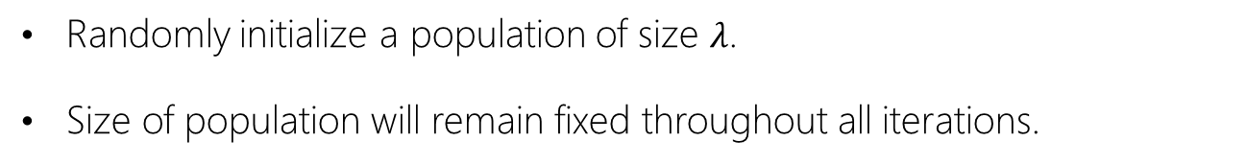

3. Encoding and operators (binary encoding)
INITIALIZATION OF POPULATION
Randomly initialize a population of size $λ$.
Size of population will remain fixed throughout all iterations.
0000
0001
0010
0110
0111
1000
1011
1100
1101
…
1111
INDIVIDUAL
POPULATION

Slide 9
3. Encoding and operators (binary encoding)
FITNESS
Within the set of possible solutions to each problema, there will always be some individuals that are closer to the optimal solution and others that are not.
The individual’s adaptation level will be measured (fitness).
0111
0001
0010
0110
0000
1000
1011
1100
1101
…
1111
0
0.85
0.84
0.65
0.92
0.02
0.4
0.52
0.35
…
0
Fitness

Slide 10

3. Encoding and operators (binary encoding)
SELECTION
Some individuals are selected to create new generations of individuals
Individuals with greater level of adaptation (fitness) will be chosen with higher probability.
Fitness
$$P∝fitness$$
0.85
0.65
0.20
0.40
0001
0110
0000
1011
Mating
pool

Slide 11
3. Encoding and operators (binary encoding)
CROSS - OVER
New generations of individuals are generated from the selected individuals, seeking individuals with even greater fitness level.
1 POINT BASED CROSS-OVER
Selected
Individuals
0001
0110
0000
1011
0
0
0
1
1
0
1
1
0
0
1
1
1
0
0
1

Slide 12
3. Encoding and operators (binary encoding)
MUTATION
The mutation operator modifies the gene of the individuals randomnly. The goal of this operator is to increase the search space in which the algorithm is looking for the solution.
Use of mutation operators are usually kept below p=0.05, as they introduce randomness to the algorithm.
0111
0001
0010
0110
0000
1000
1011
1100
1101
…
1111
BIT MUTATION OPERATOR
1
1
0
1
1
0
0
1

Slide 13
3. Encoding and operators (binary encoding)
REPLACEMENT (ELITISM)
The elitist replacement operator chooses only the individuals with the highest fitness among previous and current generation of individuals, to create next iteration’s population.
The rest are eliminated.
Previous population
New population
0000
0001
0010
0110
0111
1000
1011
1100
1101
…
1111
New
Generation
0001
0010
0110
0111
1000
1011
…
0110
1101
0010
0110
0110
1101
0110

Slide 14
REAL ENCODING

Slide 15
3. Encoding and operators (real encoding)
INITIALIZATION OF POPULATION
Randomly initialize a population of size $λ$.
Size of population will remain fixed throughout all iterations.
7
6
3
2
15
45
8
12
…
15
21
INDIVIDUAL
POPULATION

Slide 16
3. Encoding and operators (real encoding)
FITNESS
Within the set of possible solutions to each problem, there will always be some individuals that are closer to the optimal solution and others that are not.
The individual’s adaptation level will be measured (fitness).
7
6
3
2
15
45
8
12
…
15
21
0
0.85
0.84
0.65
0.92
0.02
0.4
0.52
0.35
…
0
Fitness

Slide 17

3. Encoding and operators (real encoding)
SELECTION
Some individuals are selected to create new generations of individuals
Individuals with greater level of adaptation (fitness) will be chosen with higher probability.
7
6
3.8
2
5.6
4.7
8
12
…
15
21
0
0.85
0.84
0.65
0.92
0.02
0.4
0.52
0.35
…
0
$P∝$ Fitness
3.8
6
5.6
2
Fitness
Mating
pool

Slide 18
3. Encoding and operators (real encoding)
CROSS-OVER
New generations of individuals are generated from the selected individuals, seeking individuals with even greater fitness level.
1-POINT CROSS OVER OPERATOR
Selected
Individuals
Cross-over point
Cross-over point
3.8
4.7
5.6
16
0
1
3
2
1
0
0
1
2
3
1
0
0
1
2
3
1
0
0
1
3
2
1
0

Slide 19

3. Encoding and operators (real encoding)
MUTATION
The mutation operator modifies the gene of the individuals randomnly. The goal of this operator is to increase the search space in which the algorithm is looking for the solution.
Use of mutation operators are usually kept below p=0.05, as they introduce randomness to the algorithm.
INDIVIDUAL
15 2.4 8 1
7 0.6 21 1.4
1.7 8.6 11 3.8
…
1.6 3.2 1.1 4.2
REAL MUTATION OPERATOR
15
2.4
8
1
15
3.2
8
1

Slide 20
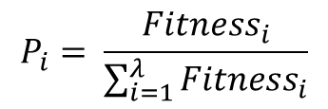
3. Encoding and operators (real encoding)
REPLACEMENT (SIMPLE REDUCTION)
Instead of using an elitist replacement method (deterministic), a probabilistic replacement method is chosen.
The rest are eliminated.
Previous population
New population
7
6
3.8
2
5.6
4.7
8
12
…
15
21
2
7
5.6
4.7
8
12
…
New
Generation
$$P_{i}= \frac{{Fitness}_{i}}{\sum_{i=1}^{λ}{{Fitness}_{i}}}$$
6.2
3.4
4.1
5.1
6.2
3.4
4.1

Slide 21
4. Pros and cons
PROS
Very efficient with intermediate scale search spaces.
Solutions very close to optimum in reasonable time
CONS
Complexity in encoding.
Convergence can be slow.
+
+
-
-

Slide 22
EXAMPLE USE CASE
- TARGET NUMBER GAME-

Slide 23
5. Target Number game
75 3 1 4 50 6 12 8
TARGET:
852

Slide 24
5. Target Number game (real encoding)
ENCODING
SEARCH
SPACE
SOLUTION
SPACE
0
1
2
3
+
-
*
/
0
1
3
2
1
0
+
-
/
*
-
+

Slide 25
5. Target Number game (real encoding)
INITIAIZATION OF POPULATION
0
1
3
2
1
0
3
2
3
1
1
0
1
1
3
2
1
0
Size of
population
…
= 20
3
0
3
1
1
0
0
1
3
2
1
0
3
2
3
1
1
0
1
1
3
2
1
0
Size of
individuals
= 7

Slide 26
5. Target Number game (real encoding)
FITNESS
+
-
/
*
-
+
*
Fitness = |852 – [75 3 1 4 50 6 12 8]|
0
1
3
2
1
0
2
+
-
/
*
-
+
*
Fitness = 72

Slide 27
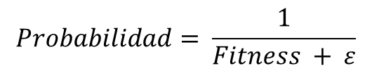
5. Target Number game (real encoding)
SELECTION
Those individuals with higher fitness are chosen with higer probability.
$$Probabilidad= \frac{1}{Fitness + ε}$$
Fitness = 72
P = 0.01389
Fitness = 402
P = 0.00248

Slide 28
5. Target Number game (real encoding)
CROSS-OVER
New generation of individuals are created from individuals with higher fitness.
Number of crossed-over pairs= 5 Cross-over probability=0.7
Cross-over point
Cross-over point
0
1
3
2
1
0
0
1
2
3
1
0
0
1
2
3
1
0
0
1
3
2
1
0
One cross-over point is chosen in order to keep building blocks together.

Slide 29
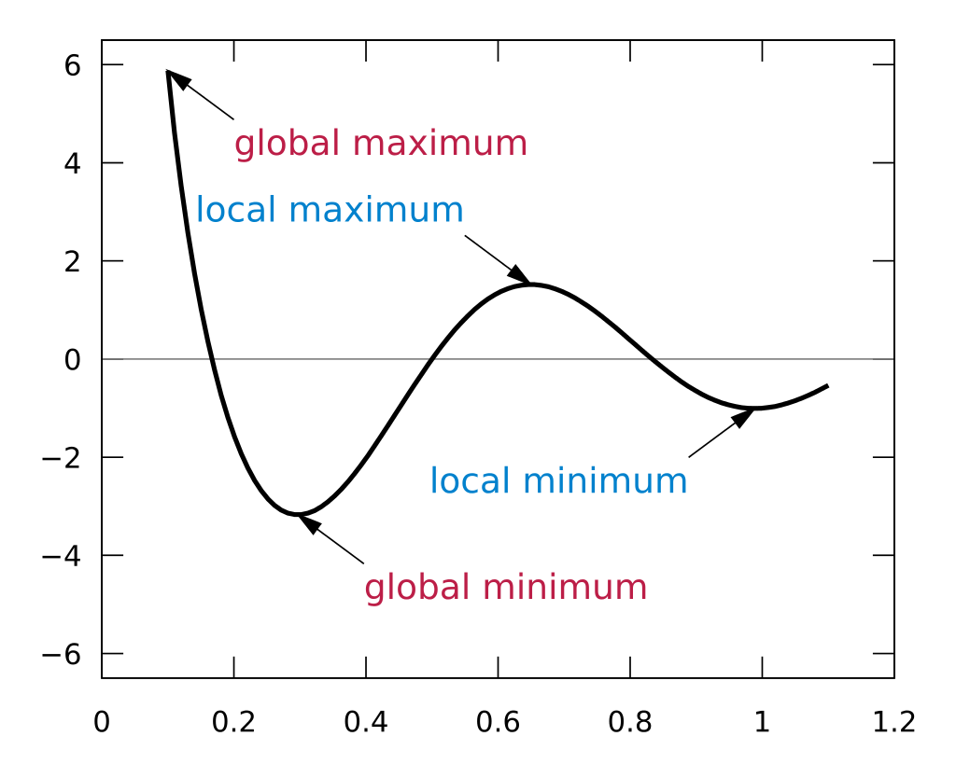
5. Target Number game (real encoding)
MUTATION
0
1
3
2
1
0
0
1
2
2
1
0
Global maximum
Local maximum
P=0.10
Local minimum
Global minimum

Slide 30
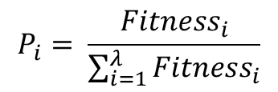
5. Target Number game (real encoding)
PROBABILISTIC REPLACEMENT
An individual’s probability of being replaced is assigned:
$$P_{i}= \frac{{Fitness}_{i}}{\sum_{i=1}^{λ}{{Fitness}_{i}}}$$
0
1
3
2
1
0
Fitness = 72
2
P = 0.0994
3
3
3
3
1
0
Fitness = 402
P = 0.5552
2
3
2
3
2
1
2
Fitness = 250
P = 0.3453
2

Slide 31
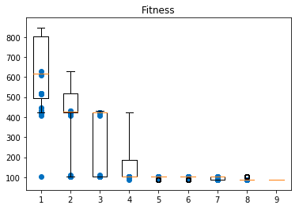
5. Target Number game (real encoding)
OVERVIEW
One simulation with 9 iterations:

Slide 32
5. Target Number game (real encoding)
PARAMETERS CHOSEN
Gene values= [+ ,- ,* , /]
Size of individuals= 7
Size of population= 20
Number of crossed-over pairs= 5
Cross-over probability = 0.70
Mutation probability= 0.10

Slide 33
5. Target Number game (real encoding)
SOLUTIONS FOUND
[2 0 2 1 1 0 1]
[2 3 2 1 0 1 0]
[* + * - - + -]
[* / * - + - +]
DECODIFICATION
Fitness = 852 – [75*3+1*4-50-6+12-8] = 0
Fitness = 852 – [75*3/1*4-50+6-12+8] = 0

Slide 34
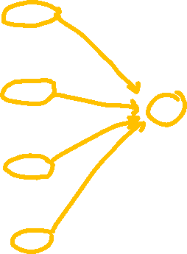
5. Target Number game (binary encoding)
ENCODING
SEARCH
SPACE
0000
0001
0010
0011
0100
0101
0110
0111
1000
1001
1010
1011
1100
1101
1110
1111
SOLUTION
SPACE
+
-
*
/
Redundancy has empirially been proven to provide faster convergence rates

